Slide 1
US Corn Price Analysis
Data Management Report
Takudzwa Rioga (946902), Emmanuele Pucci (939157)
Pouya Sotoudeh (946920), Federica Brasca (907082)

Slide 2
Project Goal & Research Questions
Analyze the drivers of US Corn prices by integrating several data sources (1973 - 2024):
November market price data (End of Season Price)
Crop and weather conditions
Supply and demand estimates
Research Questions:
What are the primary drivers of US corn prices, and has the market structure changed over time?
How does the long-term stability of production trends contrast with structural regime shifts in market pricing?

Slide 3
Project Architecture
Data Revision and Updating
The project is built to allow individual data sources to be revised should there be updated data. The interface allows you to repeat the pipeline rebuilding the data and completing the cycle, allowing easy iteration
Extract / Load / Transform
The first layer of our pipeline begins with data collection using Python, storage in BigQuery and transformation using dbt (Data Build Tool)
04
01
03
Testing
Testing, also performed using dbt, ensures our data’s integrity and correctness. Testing for accuracy and data integrity
Exploratory Data Analysis
This phase looks to derive meaning from the data collected, making sense of the observable trends in our data
02

Slide 4
Datasets & Data Scraping

Slide 5
WHAT HAS BEEN PERFORMED
Dynamic Web Scraping: Extract data needed from the sources.
DataFrame Creation: Create the DataFrames used for the entire project.

Slide 6
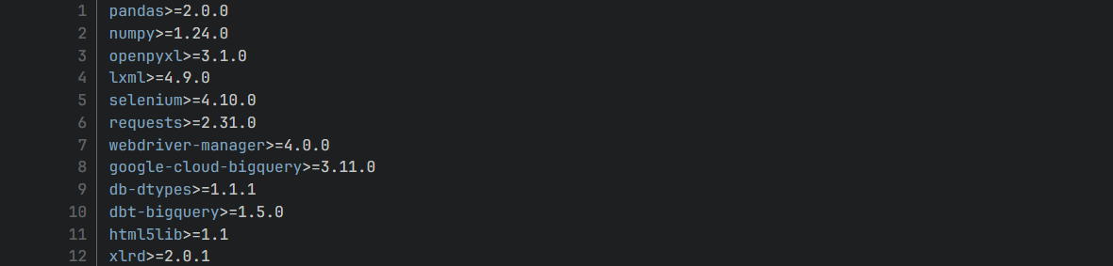
Requirements
The Data Scraping stage is implemented with Python 3.8+ and the following libraries:

Slide 7
Sources
US Corn Supply & Demand
Source: USDA Corn Supply Demand Report (Excel)
Sheet: Annual Data
Years: 1973–2024 (exclude 2025 estimates)
Key Metrics:
  Acres planted & harvested
  Yield
  Production, supply, usage
  Imports, exports, ending stocks

Slide 8
Sources
2. USDA QuickStats
Data collected through dynamic web scraping:
Corn Price - monthly data from 1973 to 2024
Crop Planting Process - weekly data from 1986 to 2024
Corn Condition - weekly data from 1986 to 2024
3. NOAA Climate Data
National rainfall & temperature (daily data from 1973 to 2024)
CSV download via URL parameters
Daily granularity for modeling flexibility

Slide 9
Dynamic Web Scraping
We automated the process of data collection from https://quickstats.nass.usda.gov/
with Selenium for dropdown driven-data.
Challenges:
Making sure the page has fully updated at every stage of the filtering process
When selecting an option from a dropdown it may happen that the previously selected option is overwritten

Slide 10
Dynamic Web Scraping
Solutions:
For the page to be fully updated and ready for the next phase, the following conditions must be met:
  wait for the dropdown to be clickable
  wait for the number of records on the top left corner of the page to change

Slide 11
Dynamic Web Scraping
2. At the very last stages of the filtering process the previously used methods are not
useful because the option selection doesn’t stuck when the page updates.
So, before the selection of the next dropdown, we are going to verify that:
the previously selected dropdown is present on the updated page
the previously selected option stuck
The data collected is stored in Pandas Data Frames and is now ready for validation
and to be loaded into BigQuery.

Slide 12
Data Loading & Transformation

Slide 13
WHAT HAS BEEN PERFORMED
Database Configuration: Configure BigQuery to receive data via an API Client.
Feature Engineering: Performing calculations on tables to create new, useful attributes for analysis.

Slide 14
Why BigQuery?
Remote Access:
  BigQuery makes it easy for each member to access the data repository without the need for a local datastore on any one workstation
Mature Package Ecosystem:
  The wide adoption and use of BigQuery means that there are many tried and tested API packages available
  This makes it relatively easy to connect to our data regardless of the tooling (Python, dbt or other)

Slide 15
Database Configuration
Project Sandboxing:
  To prevent undue charges using the Google Cloud Platform, where BigQuery is hosted, we made use of a Sandbox Environment
  Though limited in computing, this setup allows for enough storage and resources to run our project
Service Account:
  A service account was provisioned for our project to allow us to make authorized API Calls from our scripts to our database
  A service key is included as a physical JSON file in our project directory

Slide 16
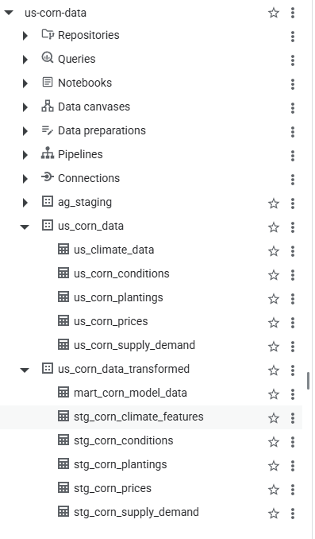
Database Transformation
Raw Data:
  The initial raw tables taken from each of our data sources are stored under the us_corn_data dataset
Transformed Data:
  Transformed data is found under us_corn_data_transformed, with each cleaned table stored in a staging table (stg_corn)
  This process allows each staged table to be cleaned individually, simplifying the SQL queries needed
  The final mart_corn_model_data table is the aggregation of all the individual staging tables

Slide 17
Feature Engineering
There are attributes that were calculated during the transformation phase
During which, redundant columns were removed and new attributes calculated to makes analysis easier
The reason for some of the transformations was their inherent data types
  For example, Crop Condition is measured categorically as a percentage of the crop being either of Very Poor, Poor, Fair, Good or Excellent condition
  To make these attributes easier to work with, we created a weighted scale scoring each level called avg_condition_pollination_index
  "Condition Index" = [(VP x 1) + (P x 2) + (F x 3) + (G x 4) + (E x 5)]/Total

Slide 18
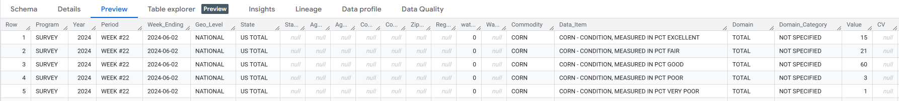
Feature Engineering
The above preview highlights the raw data for one week as taken from the Quick Stats Website
In dbt we needed to first change the week ending column into a single week number of the year between 1 - 52, creating a temporary column week_num
We simplify the descriptions from …Fair, Good, etc… to just vp, p, f, g, e
Then we group by year, and week_num and apply the equation
Then take the average by group between a range to arrive at a final index

Slide 19
Feature Engineering
We performed feature engineering in a similar fashion to attain the columns:
  avg_condition_pollination_index (Weighted average crop condition during pollination)
  planting_50_pct_doy (The approximate day when 50% of all crop was planted)
  temp_stress_july_count (Approximate count of degrees above 30 degrees celsius in July)
  post_pollination_rain (The amount of rain received after pollination)
  rainfall_effectiveness_index (Spring Rainfall normalized against planting_50_pct_doy)
  stock_to_use_ratio (Ratio of total_stock / total_usage. This compresses our other columns)

Slide 20
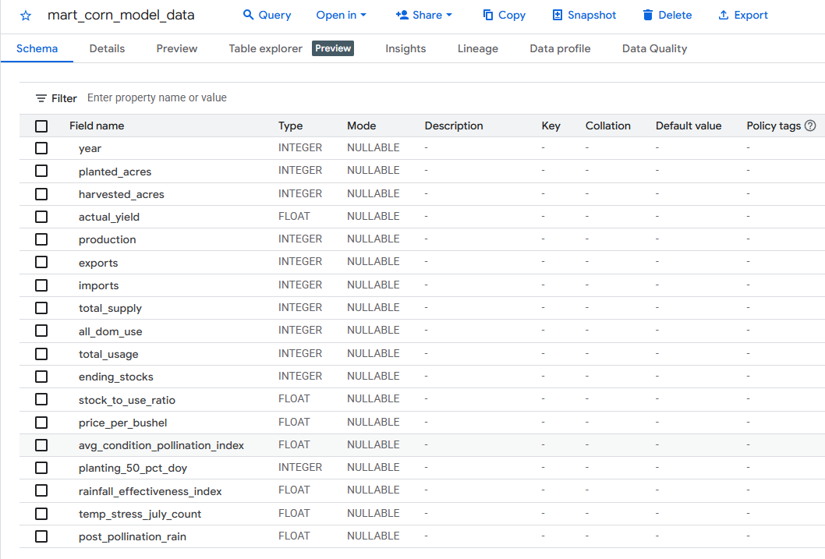
Feature Engineering
This is the schema for our final data mart, enriched with attributes from our other staging tables

Slide 21
Quality Testing

Slide 22
WHAT HAS BEEN PERFORMED
Pipeline Verification: Ensured deterministic and reproducible transformations.
Schema Validation: Enforce uniqueness, completeness, and type consistency of keys.
Business Logic Validation: Applied domain-based physics checks for plausibility.
Temporal Consistency: Retained only years with complete and consistent features.

Slide 23
Testing Framework (dbt)
Automated Testing Layer: Implemented 24+ dbt tests across staging, intermediate, and mart layers
Shift-Left Quality Control: Data quality was enforced immediately after transformation, prior to any exploratory or statistical analysis
Fail-Fast Design Principle: Any test failure halted the pipeline, preventing invalid data from propagating downstream
Layer-Aware Testing Strategy: Applied different test types per layer, ranging from schema validation in staging to business-rule enforcement in marts
Version-Controlled Assumptions: Encoded all quality rules directly in the dbt project, ensuring transparency, reviewability, and reproducibility

Slide 24
Test Categories
Schema & Structural Tests
    unique and not_null constraints on yearly primary keys
    Prevention of duplicate records and join-induced fan-out
Business Logic (“Physics”) Tests
    Precipitation values constrained to non-negative domain
    Crop condition index bounded strictly between 1 and 5
    Stocks-to-use ratios restricted to mathematically plausible ranges
Referential Integrity
    Final mart constructed using strict inner joins
    Implicit exclusion of years with missing or partial feature coverage

Slide 25
Automation & Documentation
Pipeline Orchestration:
A Python-based runner executed dbt models and tests sequentially, enforcing test-first execution
Governance & Transparency:
dbt Docs generated a searchable data catalog and full lineage graph, enabling traceability from final metrics back to raw sources

Slide 26
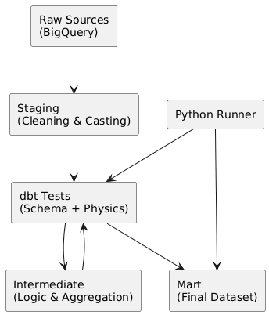
Why This Matters (Link to EDA)
Ensures exploratory findings are not driven by structural data errors
Converts subjective validation into formal, repeatable guarantees
Makes analytical conclusions auditable and reproducible

Slide 27
Exploratory Data Analysis

Slide 28
WHAT HAS BEEN PERFORMED
Pipeline Verification: Confirmed analytical table integrity.
Feature Logic: Verified agronomic and economic plausibility.
Anomaly Detection: Flagged key outliers (e.g., 1988, 2012).
Temporal Analysis: Assessed trends and time-series effects.

Slide 29
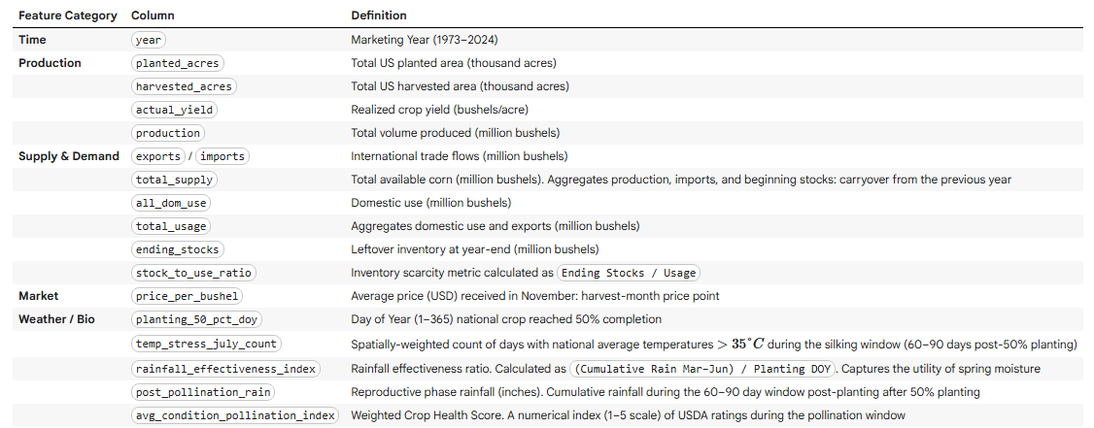
Final Dataset

Slide 30

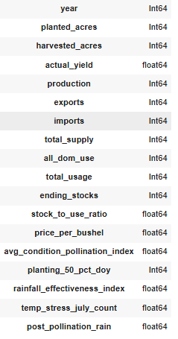
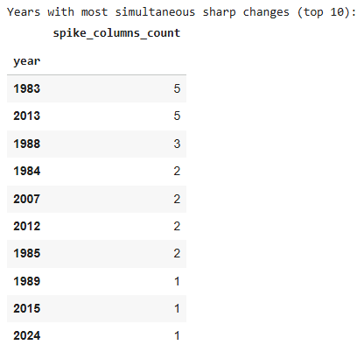

Initial Inspection

Slide 31
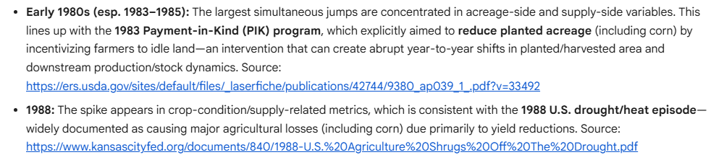
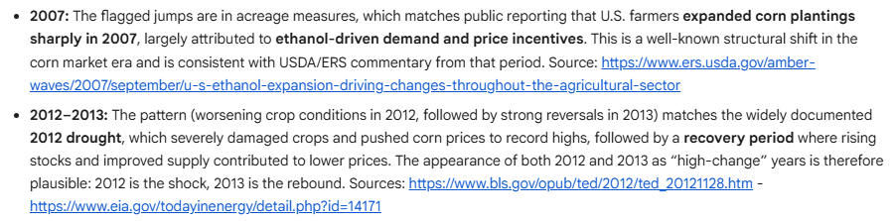
External Validation

Slide 32
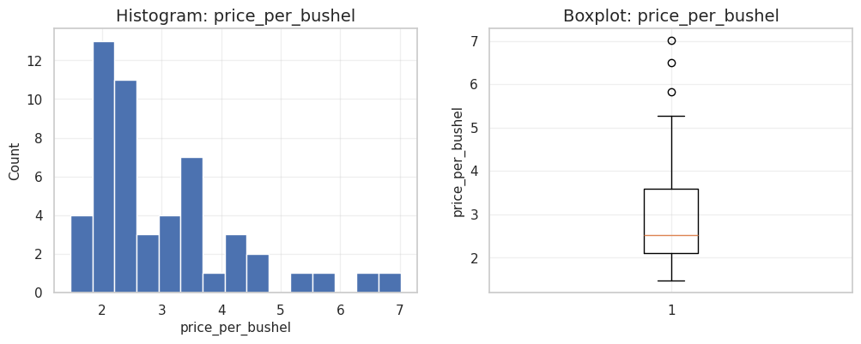
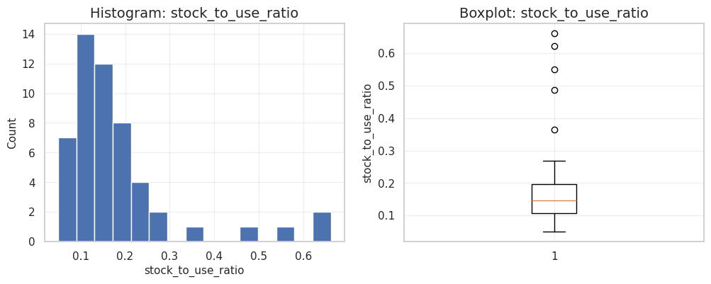
Statistical Profiling
Price
Log-transformed to correct right-skew
Outliers
Retained as valid market/climate signals (not noise)

Slide 33
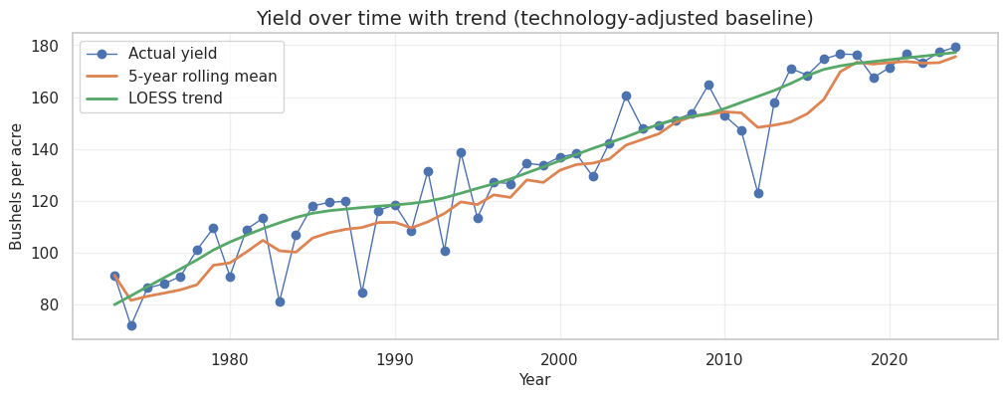
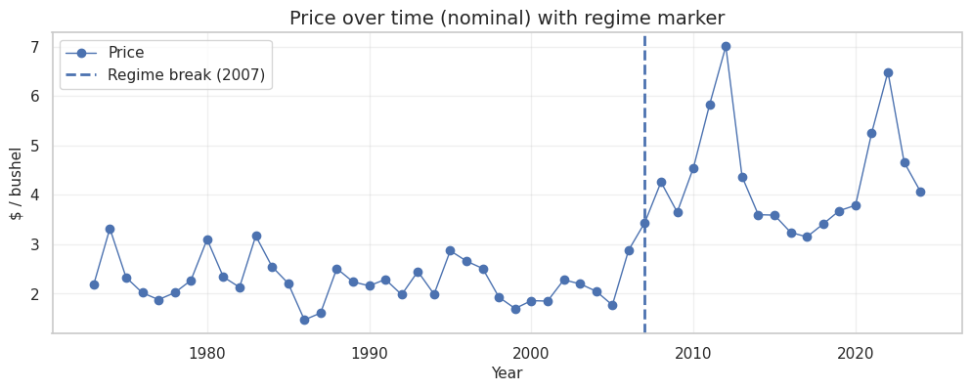
Trends & Stationarity

Slide 34
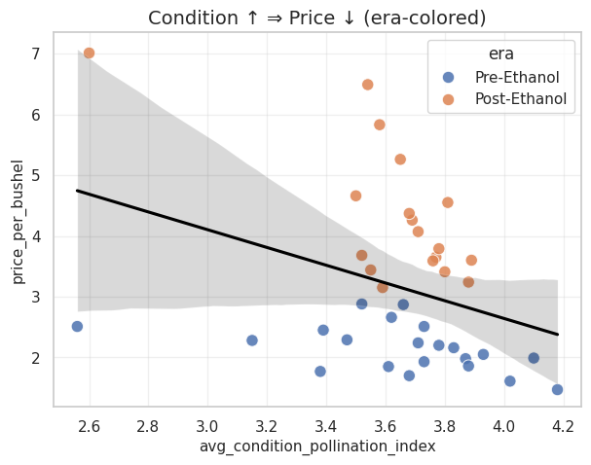
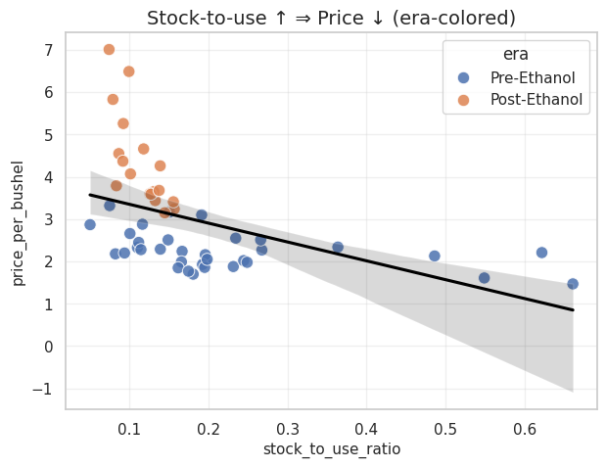
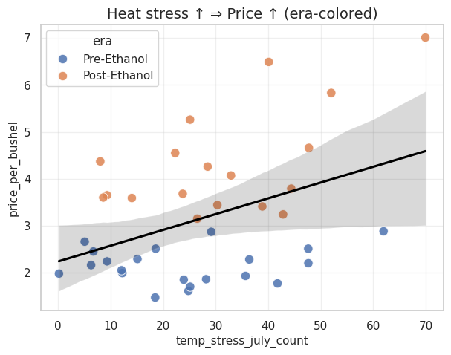
Relationships with Price
Crop Condition
Stock-to-use
Heat Stress

Slide 35
Future work / Improvements
Dashboard Integration
Containerization
CI/CD

Slide 36
Thanks for your attention!
Supplementary materials and data repository here

